Slide 1
SECURE DATA HIDING IN IMAGES USING STEGANOGRAPHY
CAPSTONE PROJECT
Presented By:MRIDUL HOWLADER
Student Name : MRIDUL HOWLADER
College Name & Department : BIPRADAS PAL CHOWDHURY
INSTITUTE OF TECHNOLOGY
COMPUTER SCIENCE & TECHNOLOGY DEPARTMENT

Slide 2
OUTLINE
Problem Statement
Technology used
Wow factor
End users
Result
Conclusion
Git-hub Link
Future scope

Slide 3
PROBLEM STATEMENT
Objective: Develop a steganography system for secure data communication by hiding a secret message within a digital image.
Requirements:
Input: A cover image (e.g., JPEG, PNG) and a secret message.
Output: An encrypted image containing the hidden secret message.
Passcode for encryption and decryption.
Features:
Encrypt the secret message by embedding it into the pixels of the cover image.
Decrypt the hidden message from the encrypted image using the correct passcode.
Constraints:
Ensure minimal visible alteration to the cover image post-embedding.
Ensure the security and integrity of the hidden message.
Applications:
Secure communication.
Digital watermarking for copyright protection.
Covert information exchange.

Slide 4
TECHNOLOGY USED
I am used here cv2 library , os library and string library in python.
The platform(IDE) that i used is vs-code.

Slide 5
WOW FACTORS
Passcode Protection: Adds an extra layer of security by requiring a passcode for both encryption and decryption.
Minimal Image Distortion: Ensures that the visual quality of the cover image is preserved, making the hidden message hard to detect.
Versatile Encryption: Can handle a wide range of secret messages, from text to binary data.
Robust Algorithm: Uses efficient indexing and pixel manipulation techniques to securely embed and extract the secret message.
Cross-Platform Compatibility: Works with various image formats and can be adapted for different operating systems.

Slide 6
END USERS
Individuals: People wanting to secure personal communications and sensitive information.
Organizations: Companies protecting confidential data and intellectual property.
Government Agencies: Securing classified information and maintaining national security.
Law Enforcement: Covertly exchanging information and conducting undercover operations.
Journalists: Safeguarding sources and sharing sensitive information securely.

Slide 7
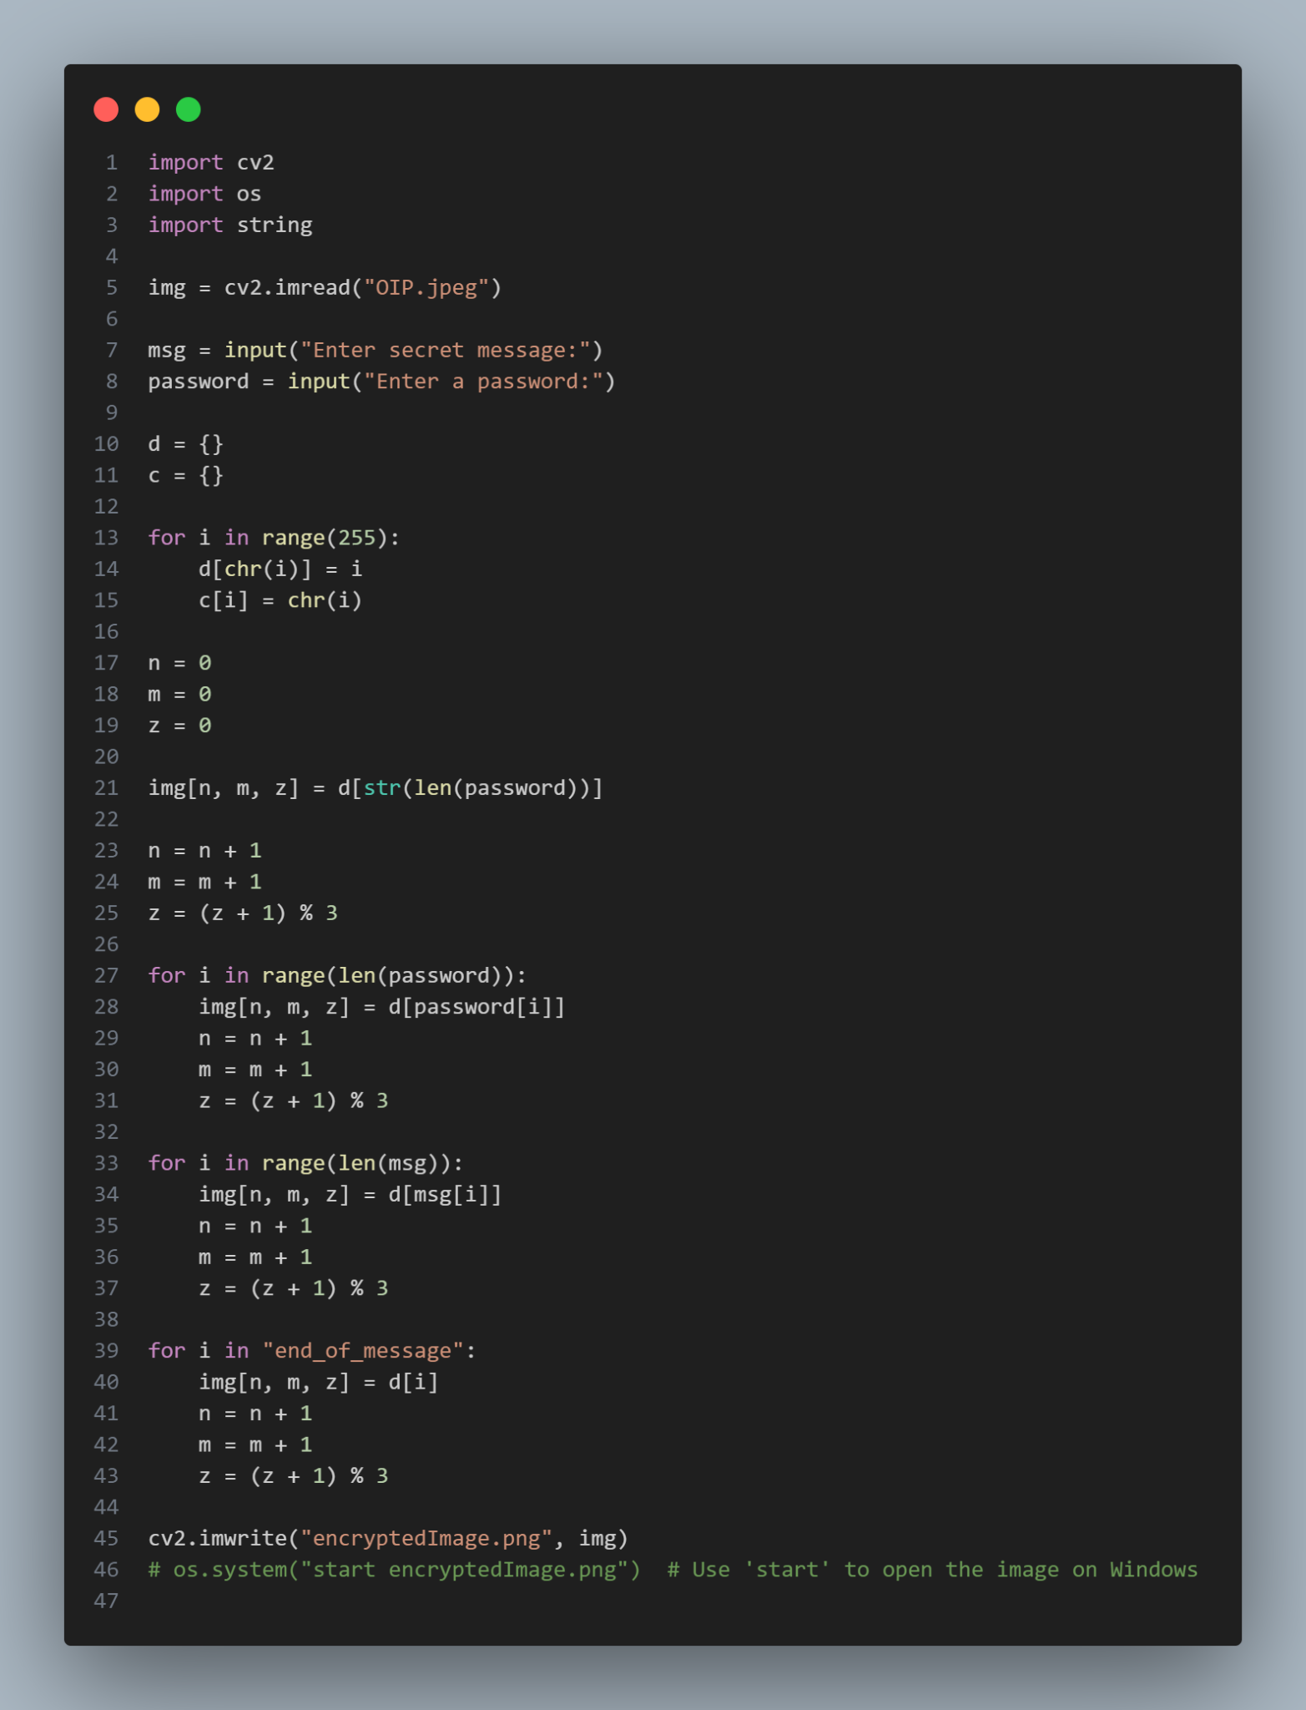
RESULTS
Encryption code

Slide 8
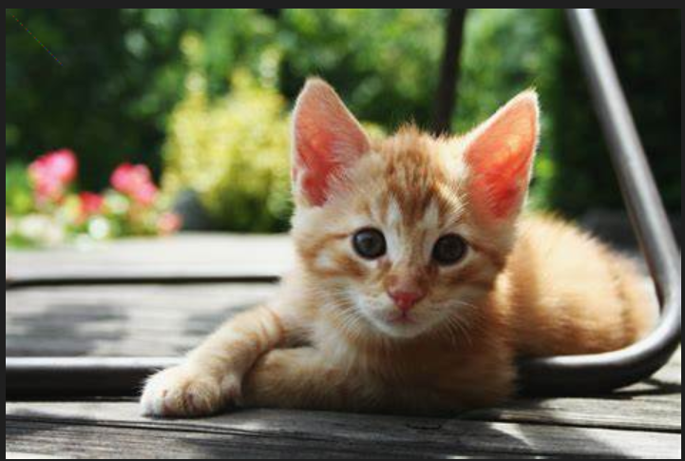
RESULTS
Encrypted Image

Slide 9
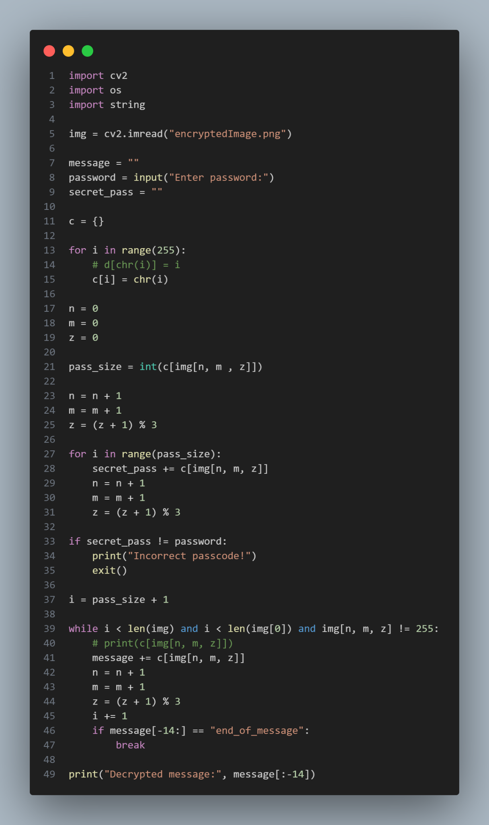
RESULTS
Decryption code

Slide 10
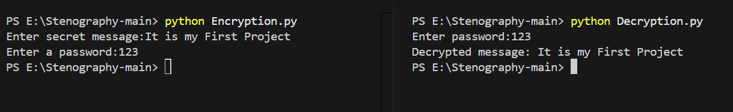
RESULTS
Output

Slide 11
CONCLUSION
Effective Data Hiding: Successfully embedded secret messages within digital images while preserving image quality.
Enhanced Security: Added passcode protection for encryption and decryption, ensuring message confidentiality.
Versatile Application: Demonstrated the potential for secure communication across various end users, including individuals, organizations, and government agencies.
Robust Algorithm: Utilized efficient algorithms for embedding and extracting messages, ensuring data integrity.
Real-World Relevance: Highlighted the importance of steganography in safeguarding sensitive information in the digital age.

Slide 12
GITHUB LINK
https://github.com/Mridul2005-eng/Steganography-Project.git

Slide 13
FUTURE SCOPE(OPTIONAL)
I want to become a Cyber Security specialist.

Slide 14
THANK YOU

